Slide 1
Identity federation: A new way to manage access to resources
SANLiC 2017 Durban, May 2017

Slide 2
Identity Federations
A brief introduction

Slide 3
Federated Identity
A federated identity in information technology is the means of linking a person's electronic identity and attributes, stored across multiple distinct identity management systems
https://en.wikipedia.org/wiki/Federated_identity
Notes:
Explain the concepts of identity, attributes, and identity management systems

Slide 4
Federated Identity
Identity Providers
(Home Organisations)
Identity Federation
Service Providers’ Web Sites

Slide 5



Why not just use Google?
All the major social network platforms provide federated identities…
… so why don’t we just use these?
They all have one major drawback – they are self asserted
This means you cannot trust any of the information
This is often okay, but…
donald.trump17@gmail.com
Notes:
Would you allow Donald.trump17@gmail.com access to sensitive medical records?

Slide 6
Academic Identity Federations
Academic identity federations exist to solve the trust problem
Your home organisation – university, research council, etc – knows a lot about you
They also know stuff specific to higher education (HEMIS, RIMS)
More importantly, most of this information has usually been checked and may be subject to audit
This makes them ideal to act as identity providers

Slide 7
Academic Federation Operators
All federations have operators
Facebook Inc operates Facebook Connect
Academic federations
Usually operated by the National Research and Education Network (NREN)
Typically only one per country
65 known academic federations worldwide

Slide 8

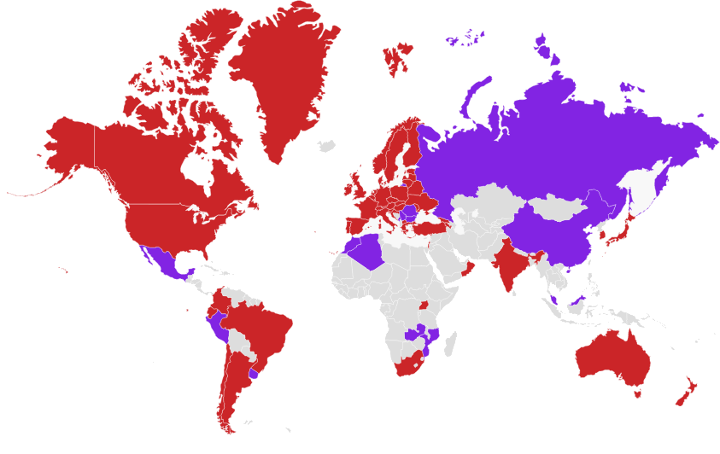
Academic Identity Federations Around the World
https://refeds.org/federations/federations-map, May 2017

Slide 9
Academic Federation Operators
Academic federations are primarily trust relationships with federation operators acting as trusted introducers
Federation operators worldwide collaborate on issues of interest to the research & education
Interoperability (R&S profile)
Common identifiers (eduPersonOrcid)
Handling of sensitive information
Security/incident response (SIRTFI)
etc…
Notes:
https://refeds.org/category/research-and-scholarship
https://refeds.org/sirtfi

Slide 10

Inter-federation
Inter-federation is the linking of one (academic) federation to another
Through inter-federation we can gain access to services that are not yet available in our own country
Service providers can gain access to customers
Notes:
http://eduGAIN.org/

Slide 11
SAFIRE
South African Identity Federation

Slide 12
SAFIRE – South African Identity Federation
Academic identity federation for South Africa
Conceived by the community and piloted over a number of years
Supported service operated by TENET
Member of eduGAIN (since February)
48th member / 41st full participant
1st member in Africa
Your IT Department should know all this…

Slide 13












SAFIRE –Participants
Notes:
CSIR, Stellenbosch University (SU), University of Cape Town (UCT), University of the Western Cape (UWC), North-West University (NWU), Nelson Mandela University (NMMU), African Research Cloud (ARC), Square Kilometer Array (SKA), SheerID
DIRISA is in the process of integrating; Sci-GaIA needs to transition

Slide 14
So what does this all mean for libraries?

Slide 15
The “traditional” licensing model
Average student carries 3+ devices.
Default IPv6 allocation for universities in South Africa has 1 208 925 819 614 629 174 706 176 IP addresses in it.
License based on some form of FTE count
Site-wide, but use restricted to the local campus network
Off-campus users must make use of a reverse proxy or VPN solution
Not easy to enforce more granular controls
IP-based restrictions don’t scale well – and are out-of-sync with the modern Internet
Notes:
https://www.ufs.ac.za/docs/librariesprovider35/default-document-library/ufs-teaching-and-learning-report-20156281b0e65b146fc79f4fff0600aa9400.pdf said 2 devices in 2015; other estimates are much higher: http://www.marketingcharts.com/online/college-students-own-an-average-of-7-tech-devices-30430/. So for this purpose, assume smartphone, tablet, and one other device (desktop/laptop/playstation/etc)

Slide 16
Reverse Proxies
Many libraries use reverse proxies to provide off-campus access to electronic resources
EZProxy
III WAM Proxy
Campus networks – indeed “campuses” – are becoming increasingly hard to define, and users are becoming increasingly mobile
Confusing for users – “why can’t I just log in like every other website I use?!”
Difficult to support & troubleshoot
As journal providers embrace SSL, these become more complicated – and expensive – to maintain
Notes:
No incentive for journal providers to reduce number of hosts

Slide 17
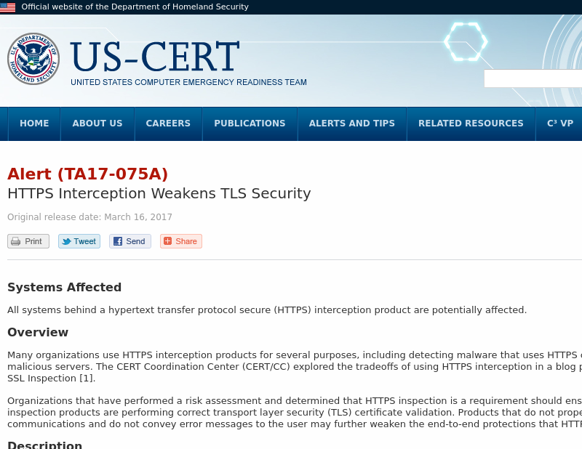
Reverse Proxies
By perpetuating reverse proxies, libraries are undermining Internet security and directly contributing to the problem of phishing
https://www.us-cert.gov/ncas/alerts/TA17-075A
Notes:
https://securityevaluators.com/knowledge/case_studies/mutual/

Slide 18
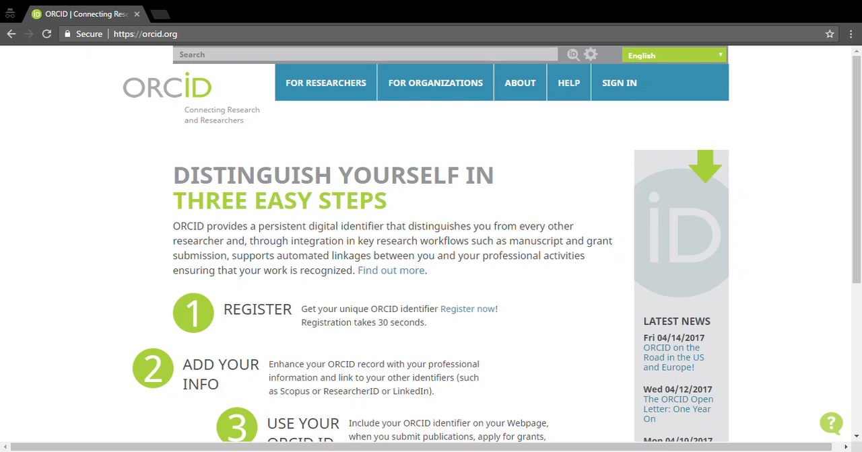
What if we could leverage of existing institutional logins?
Notes:
Demo log into https://orcid.org/

Slide 19
What if we could license in a more specific way?
schacHomeOrganizationType
urn:schac:homeOrganizationType:int:university
schacHomeOrganization
example.ac.za
eduPersonAffiliation
faculty
employee
member
eduPersonScopedAffiliation
student@archaeology.example.ac.za
faculty@law.example.ac.za
employee@example.ac.za
member@example.ac.za
Notes:
http://safire.ac.za/technical/attributes/

Slide 20
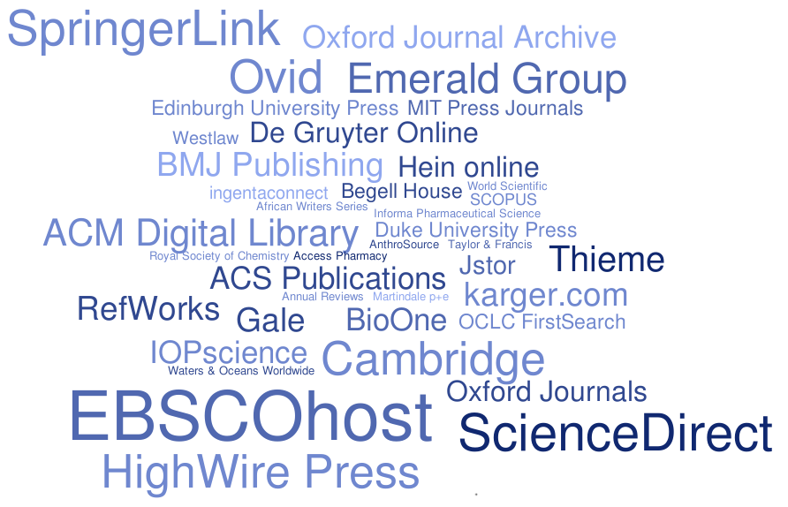
What if we could benefit from the integration work done by others?
Rhodes University Library & eduGAIN MET, August 2016
Notes:
Tag cloud shows frequency (number of federations) of various academic publishers in eduGAIN metadata

Slide 21
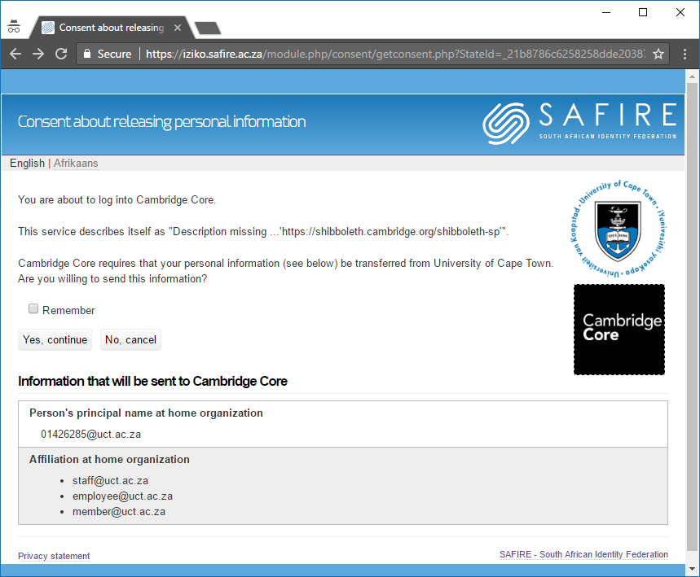
What if we could do this whilst still protecting personal privacy?
Notes:
Consent interface – mandatory consent helps with POPI compliance

Slide 22
Federation…
Provides a new approach to electronic resource management
Gives better control over who has access to your resources = better compliance with licensing agreements
Allows you to downsize/decommission reverse proxies
Is less confusing for your users
Saves you money…

Slide 23
FIM4R Findings (2012)
Federated technologies are good. Take advantage of them.
The infrastructure needs to be improved to take advantage of federated technologies. Do it.
Relying on older models of local account creation and IP-based ACLs is easier. This is a very limited view. Stop it.
If you can’t fix it all yourself (and you can’t), facilitate the efforts of groups that can. Build relationships, target your spending or funding to make the biggest impact.
Source: http://cds.cern.ch/record/1442597 Via: https://learn.nsrc.org/fedidm/iam_researchers
Notes:
FIM4R is the Federated Identity Management for Researchers working group, comprising researchers from large science projects like CERN, Science & Technology Facilities Council (UK), European Bioinformatics Group, etc. They published findings in 2012, which are summarised on this page. Heather Flannigan expands on them at https://learn.nsrc.org/fedidm/iam_researchers

Slide 24

Questions?
https://safire.ac.za/
safire@tenet.ac.za

Slide 25
The problem we’re trying to solve

